Slide 1
M.Tech DSE Machine Learning
Dr. Monali Mavani
Source: “Probabilistic Machine Learning, An Introduction”, Kevin P. Murphy, Slides of Prof. Chetana from BITS Pilani , CS109 stanford lecture notes and many others who made their course materials freely available online.

Slide 2
Lecture No. – 2 | Math and Stat Preliminaries

Slide 3
Session Content
Linear Algebra Review
Calculus Review
Probability Theory
Decision Theory

Slide 4
Linear algebra Review

Slide 5
Vectors and Matrices
Collections of ordered numbers that represent movements in space, word counts, movie ratings, pixel brightness, etc.
Vector is a mathematical quantity that has magnitude and direction

Slide 6
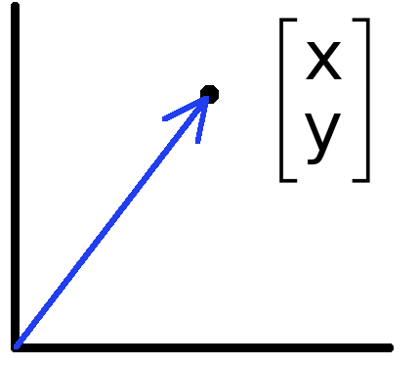
Vectors
Vectors can represent an offset in 2D or 3D space
Points are just vectors from the origin
Data can also be treated as a vector

Slide 7
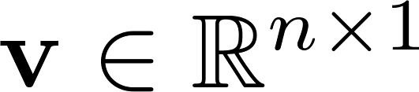
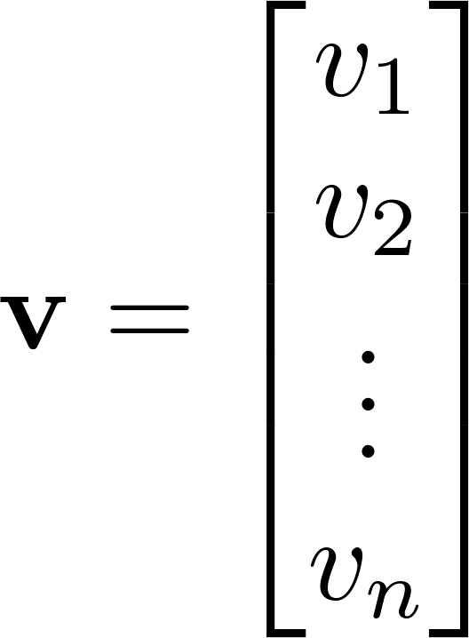
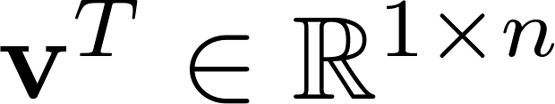
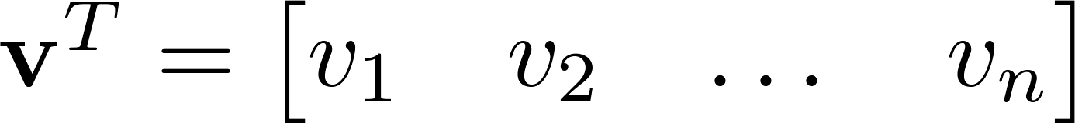

Vector
A column vector where
A row vector where
denotes the transpose operation

Slide 8
Product of 2 Vectors
Three ways to multiply
Element-by-element
Inner product
Outer product
Cross product

Slide 9
Element-by-element product (Hadamard product)

Slide 10
Multiplication: Dot product (inner product)
The dot product represents the similarity between vectors as a single number:
If two vectors are in the same direction the dot product is positive and if they are in the opposite direction the dot product is negative.
1 X N
N X 1
1 X 1
Outer dimensions give
size of resulting matrix
Slide credit: Mark Goldman and Emily Mackevicius

Slide 11
Dot product geometric intuition: “Overlap” of 2 vectors
Slide credit: Mark Goldman and Emily Mackevicius

Slide 12
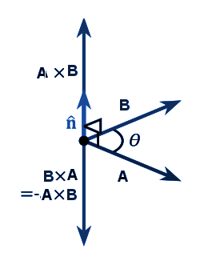
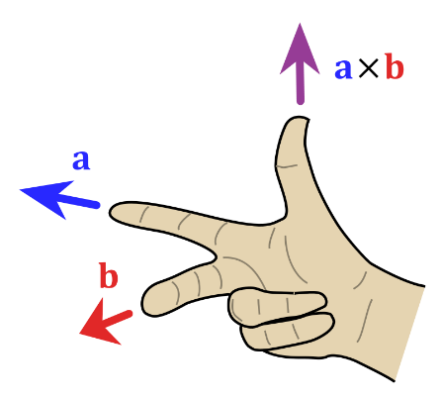
Cross product
The cross product of two vectors a and b is defined only in three-dimensional space and is denoted by a × b.
n is a unit vector perpendicular to the plane containing a and b, in the direction given by the right-hand rule

Slide 13
Multiplication: Outer product
N X 1
1 X M
N X M
Slide credit: Mark Goldman and Emily Mackevicius

Slide 14
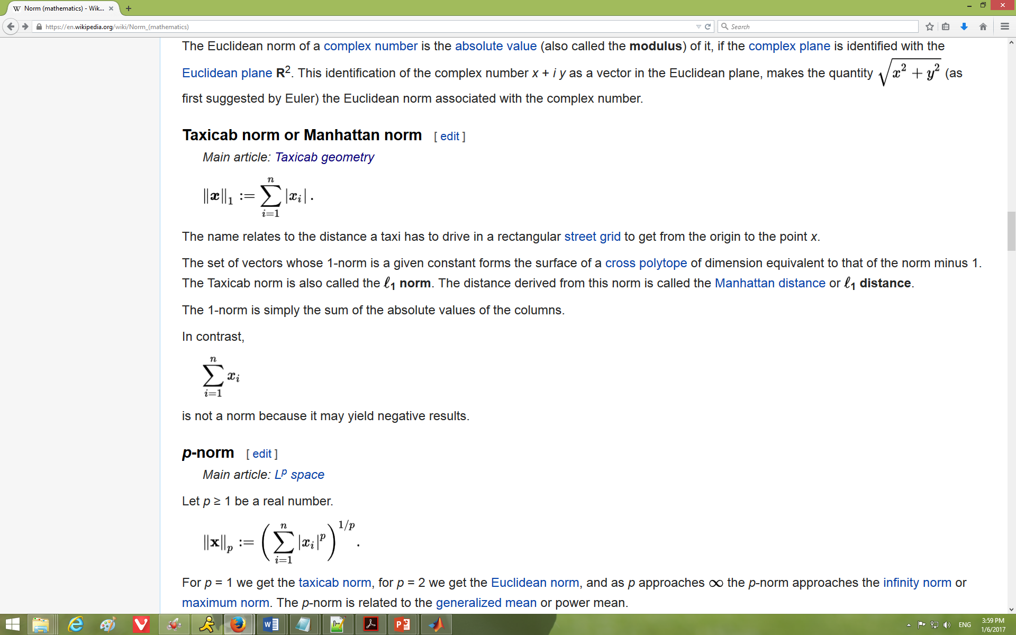
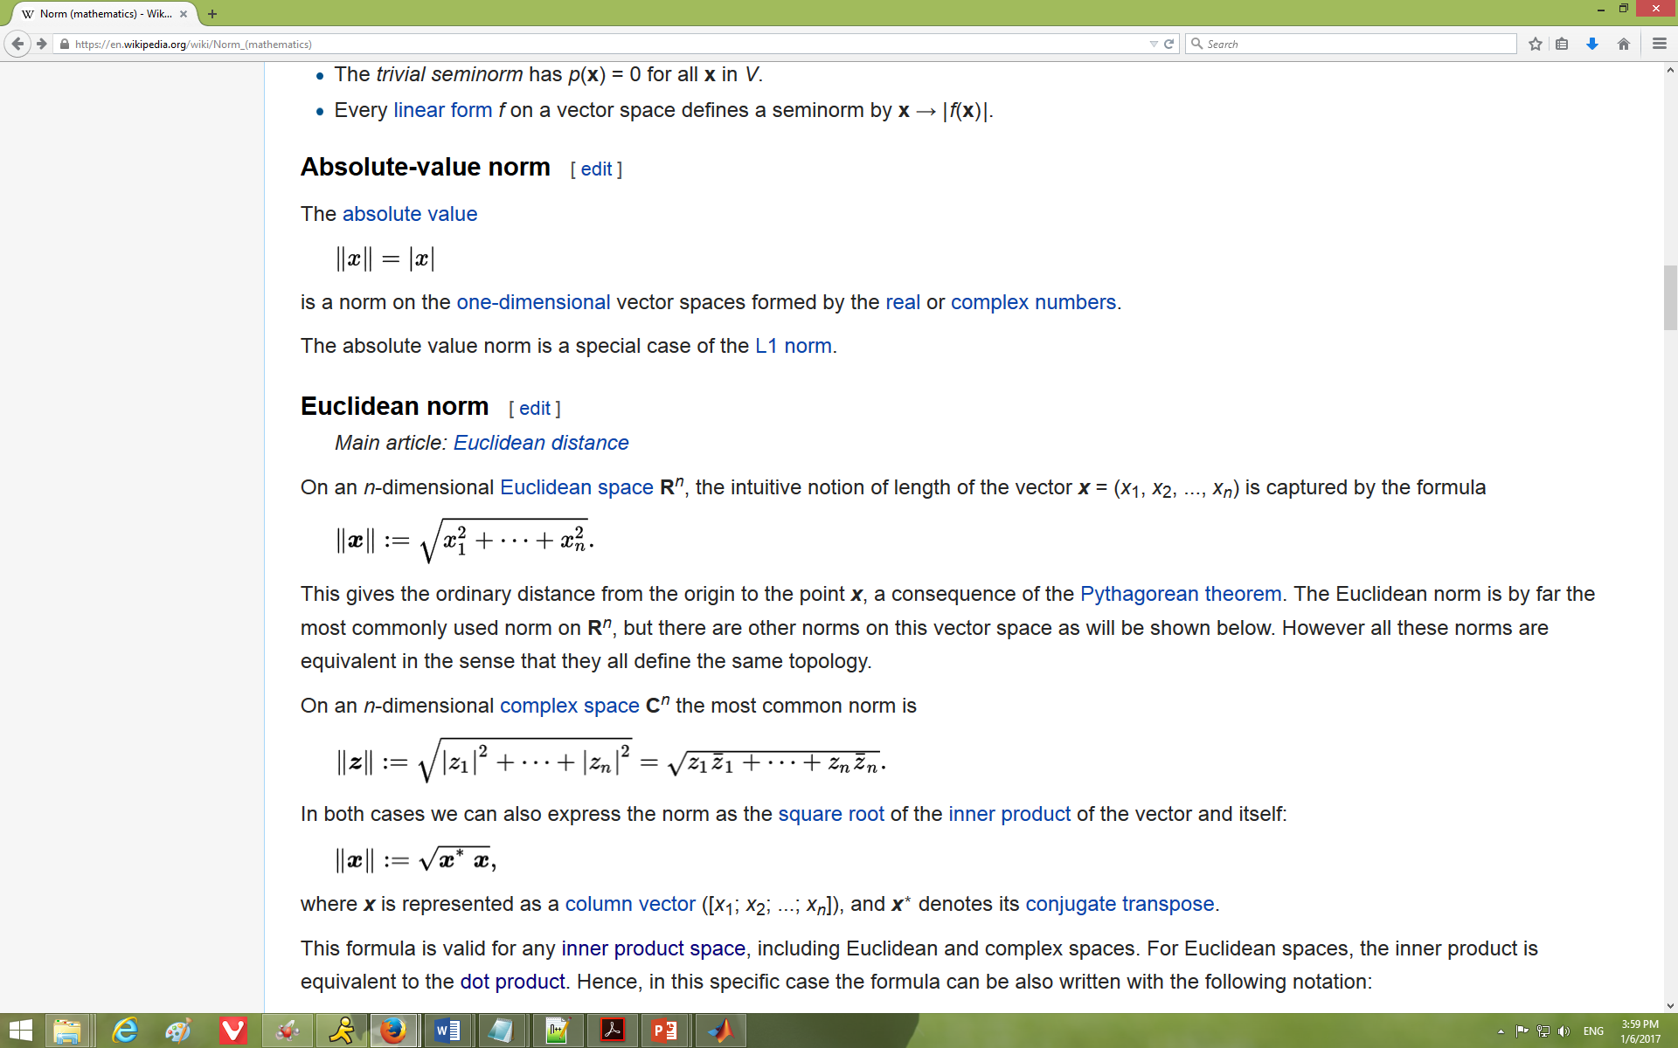
Norm
Norm is a function that assigns a strictly positive length or size to each vector in a vector space—except for the zero vector
L¹ norm - Manhattan/Taxicab Distance, the Mean Absolute Error (MAE), or the Least Absolute Shrinkage and Selection Operator (LASSO)
L² norm - Euclidean Distance, the Mean Squared Error (MSE) / Least Squares Error, or the Ridge Operator

Slide 15
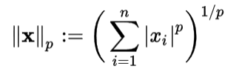
Norm
L^{p} norm - Let p ≥ 1 be a real number. The p norm of vector x=(x₁, x₂,…x_{n})
Matrix norm

Slide 16
Orthogonal and Orthonormal Vectors
A.B=0 then A and B are orthogonal
A collection of vectors a₁, . . . , a_{k} is orthogonal if a_{i} ⊥ a_{j} for with i ≠ j
A collection of vectors a₁, . . . , a_{k} is orthonormal if the set of vectors are mutually orthogonal and if every vector has magnitude 1 ( ||a_{i}|| = 1 )
normalized or unit vector: A vector of norm one
normalizing : dividing a vector by its norm

Slide 17
Euclidean distance
u and v are n dim vectors

Slide 18
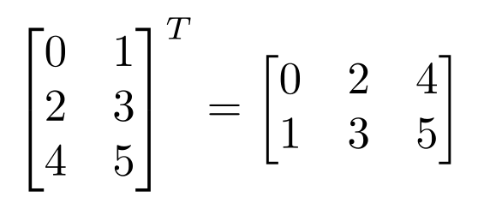
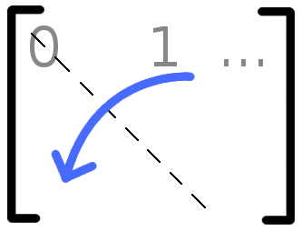
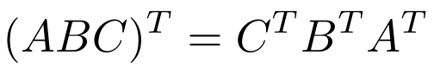
Matrix Operations
Transpose – flip matrix, so row 1 becomes column 1
A useful identity:

Slide 19
Matrix times a vector
M X 1
M X N
N X 1
Slide credit: Mark Goldman and Emily Mackevicius

Slide 20
Matrix times a vector: inner product interpretation
Rule: the i^{th} element of y is the dot product of the i^{th} row of W with x
matrix-vector product is really a dot product in disguise.
Slide credit: Mark Goldman and Emily Mackevicius

Slide 21
Product of 2 Matrices
Note: Matrix multiplication doesn’t (generally) commute, AB ≠ BA
N X P
P X M
N X M
Slide credit: Mark Goldman and Emily Mackevicius

Slide 22
Matrix times Matrix: Matrix Multiplication by inner products
C_{ij} is the inner product of the i^{th} row of A with the j^{th} column of B
matrix product C = AB (denoted without multiplication signs or dots)
Slide credit: Mark Goldman and Emily Mackevicius

Slide 23
Special matrices: diagonal matrix
This acts like scalar multiplication
Slide credit: Mark Goldman and Emily Mackevicius

Slide 24
Special matrices: identity matrix
for all
A square matrix A is symmetric if A = A^{T} , i.e., A_{ij} = A_{ji} for all i; j.
Slide credit: Mark Goldman and Emily Mackevicius

Slide 25
Different types of product
x, y = column vectors (nx1)
X, Y = matrices (mxn)
x, y = scalars (1x1)
x^{T} y = x · y = inner product (1xn x nx1 = scalar)
x ⊗ y = x y^{T} = outer product (nx1 x 1xn = matrix)
X * Y = matrix product
X .* Y = element-wise product

Slide 26
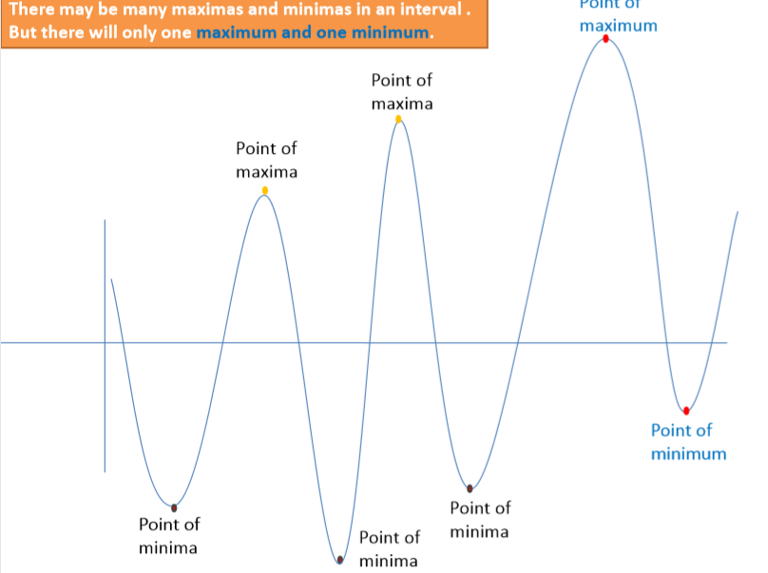
Maxima and Minima of a function

Slide 27
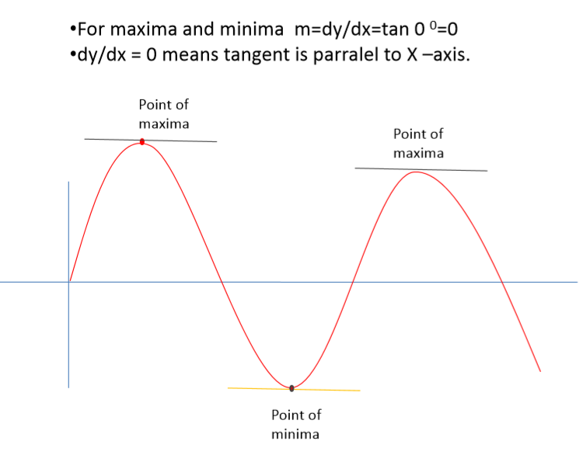
Maxima and Minima

Slide 28
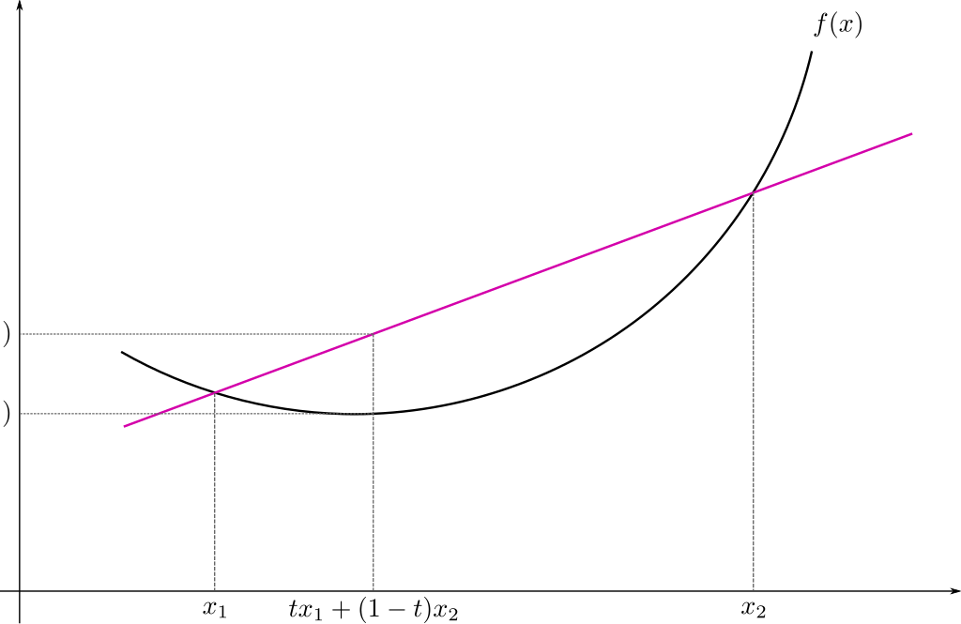
Convex Function
Real-valued function defined on an n-dimensional interval is called convex if the line segment between any two points on the graph of the function lies above or on the graph

Slide 29
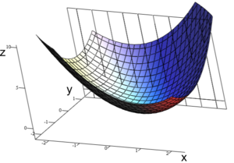
Convex Function : Multivariate

Slide 30
Calculus review

Slide 31
Differentiation
The derivative provides us information about the rate of change of a function.
The derivative of a function is also a function. Example:
The derivative of the acceleration function is the velocity function.
Texas A&M Dept of Statistics

Slide 32
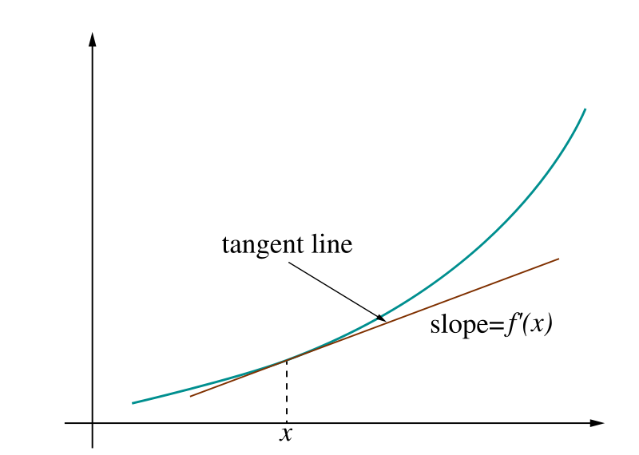
Derivative = rate of change
Image: Wikipedia

Slide 33
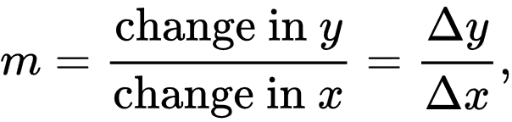
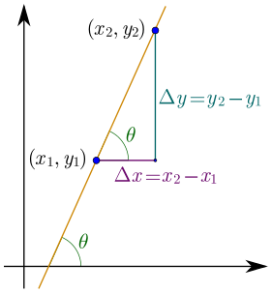
Derivative = rate of change
Linear function y = mx + b
Slope
Image: Wikipedia

Slide 34
Ways to Write the Derivative
Given the function f(x), we can write its derivative in the following ways:
- f '(x)
- ^{d} f(x)
dx
The derivative of x is commonly written dx.
Texas A&M Dept of Statistics

Slide 35
Differentiation Formulas
The following are common differentiation formulas:
- The derivative of a constant is 0.
^{d} c = 0
du
- The derivative of a sum is the sum of the derivatives.
^{d} ( f (u) + g(u)) = f '(u) + g'(u)
du
Texas A&M Dept of Statistics

Slide 36
More Formulas
- The derivative of u to a constant power:
^{d} u^{n} = n *u^{n−1}
du
- The derivative of e:
^{d} e^{u} = e^{u}
du
- The derivative of log:
^{d} log(u) = ¹ du u
Texas A&M Dept of Statistics

Slide 37
Product and Quotient
The product rule and quotient rules are commonly used in differentiation.
- Product rule:
^{d} ( f (u)* g(u)) = f (u)g'(u) + g(u) f '(u)
du
- Quotient rule:
( )
d f (u)
g(u) f '(u) − f (u)g'(u)
=
du g(u)
2
g (u)
Texas A&M Dept of Statistics

Slide 38
Chain Rule
The chain rule allows you to combine any of the differentiation rules we have already covered.
- First, do the derivative of the outside and then do the derivative of the inside.
d
f (g(u)) = f '(g(u))* g'(u)* du
du
Texas A&M Dept of Statistics

Slide 39
Try These
f (z) = z +11
s( y) = 4 ye^{2 y}
log(x² )
g( y) = 4 y³ + 2 y
p(x) =
x
h(x) = e^{3x}
Texas A&M Dept of Statistics

Slide 40
Solutions
f '(z) = 1
s'( y) = 8ye^{2 y}
4e^{2 y}
2 − log(x² )
p'(x) =
_{x}2
g'( y) = 12 y² + 2
h'(x) = 3e^{3x}
Texas A&M Dept of Statistics

Slide 41
Probability Review

Slide 42
Two main "schools of thought"
Bayesian probability= degree of belief
Probabilities are assigned to events based on evidence and personal belief and are centered around Bayes' theorem
p(heads=1)=0.5 means you think the event that a particular coin will land heads is 50% likely.
Frequentist probability= long run frequencies
Events are observed and counted, and their frequencies provide the basis for directly calculating a probability
p(heads=1)=0.5 means that the empirical fraction of times this event will occur across infinitely repeated trials

Slide 43

Probability – Meaning & Concepts
An experiment in probability:
𝐸
𝑆
Experiment
Outcome
Sample Space, 𝑆: Event, 𝐸:
The set of all possible outcomes of an experiment Some subset of 𝑆 (𝐸 ⊆ 𝑆).
43

Slide 44
Probability – Meaning & Concepts
Sample Space, 𝑆
Coin flip
𝑆 = {Heads, Tails}
Roll of 6-sided die
𝑆 = {1, 2, 3, 4, 5, 6}
# emails in a day
𝑆 = {𝑥 | 𝑥 ∈ ℤ, 𝑥 ≥ 0}
Event, 𝐸
Flip lands heads
𝐸 = {Heads}
Roll is 3 or less:
𝐸 = {1, 2, 3}
Low email day (≤ 20 emails)
𝐸 = {𝑥 | 𝑥 ∈ ℤ, 0 ≤ 𝑥 ≤ 20}
𝑛 = # of total trials
𝑛(𝐸) = # trials where 𝐸 occurs
44
Slide Credit : Lisa Yan

Slide 45
3 Axioms of Probability
Axiom 1: 0 ≤ P(E) ≤ 1
Axiom 2: P(S) = 1
Axiom 3: If E and F mutually exclusive (E ∩ F = ∅),
then P(E) + P(F) = P(E ∪ F)

Slide 46
Conditional Probability
The probability of E given that (aka conditioned on) event F already happened:
It allows us to update our beliefs in the face of new evidence – critical in machine learning
The Chain Rule:
P(EF) = P(E | F) P(F)
general form:

Slide 47
The Law of Total Probability
For events E and F
Let E1,E2,……., En are mutually exclusive and exhaustive i.e every
outcome in sample space falls into exactly one of those events then
giving a general form:

Slide 48
Example
P(Cancer) =1/100
P(+/Cancer)=90/100
P(+/Not Cancer)=8/100
P(Cancer/+)=?

Slide 50
Bayes Rule
𝑃 (𝐸 = Evidence | 𝐹 = Fact)
(collected from data)
Bayes
𝑃 (𝐹 = Fact | 𝐸 = Evidence)
(categorize a new datapoint)

Slide 51
Bayes Rule
Common form

Slide 52
Bayes Rule
Expanded form

Slide 53
Bayes’ Theorem terminology
posterior
likelihood prior
₌ 𝑃 𝐸 𝐹 𝑃 𝐹
𝑃(𝐹|𝐸)
𝑃(𝐸)
normalization constant
Given new evidence 𝐸, update belief of fact 𝐹
Prior belief → Posterior belief
𝑃(𝐹) → 𝑃(𝐹|𝐸)

Slide 54
Example
60% of all email received is spam.
20% of spam has the word “Dear”
1% of non-spam has the word “Dear”
You get an email with the word “Dear” in it. What is the probability that the email is spam?

Slide 55
Independence
Two events E and F are called independent if:
P(EF) = P(E) P(F) equivalently: P(E | F) = P(E)
Otherwise, they are called dependent events
Three events E, F, and G independent if:
P(EFG) = P(E) P(F) P(G), and
P(EF) = P(E) P(F), and
P(EG) = P(E) P(G), and
P(FG) = P(F) P(G)

Slide 56
Probability of events
P(AB)
Generally: P(A)P(B|A)
Independent: P(A)P(B)
P(A∪B)
Generally: P(A) + P(B) – P(AB)
Mutually Exclusive: P(A) + P(B)

Slide 57
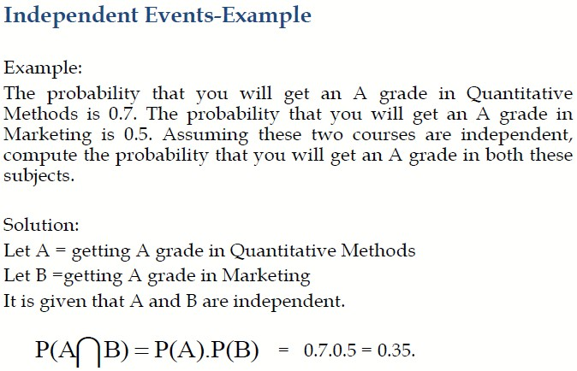

Slide 58

Random Variable
CS variables
Random variables
name
int a = 5;
𝐴 is the number of Pokemon we bring to our future battle.
𝐴 ∈ 1, 2, … , 6
type
value
Random variables are like typed variables (with uncertainty)
A random variable is a real-valued function defined
on a sample space.
Experiment
Outcome
0 = 𝑘

Slide 59
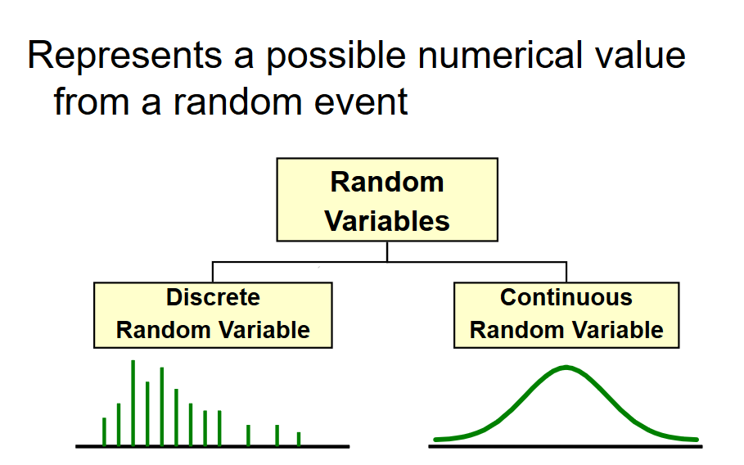
Random Variable

Slide 60
Example
we flip three fair coins. A random variable Y is the total
number of “heads” on the three coins
P(Y = 0) = 1/8 (T, T, T)
P(Y = 1) = 3/8 (H, T, T), (T, H, T), (T, T, H)
P(Y = 2) = 3/8 (H, H, T), (H, T, H), (T, H, H)
P(Y = 3) = 1/8 (H, H, H)
P(Y = 4) = 0
It is confusing that random variables and events use the same notation.
Random variables ≠ events.
We can define an event to be a particular assignment of a random variable.

Slide 61
Probability distributions
It is the mathematical function that gives the probabilities of occurrence of different possible outcomes for an experiment.

Slide 62
PMF and CMF
The probability mass function (PMF) of a random variable is a function that maps possible outcomes of a random variable to the corresponding probabilities.
It can be written as : 𝑃(X = 𝑥) = 𝑝(𝑥) = 𝑝_{X}(𝑥)
the cumulative distribution function (CDF) is defined as
𝐹( 𝑎)= 𝐹_{x} (𝑎)= 𝑃(X≤ 𝑎) where − ∞ < 𝑎 < ∞
For a discrete RV X the CDF is

Slide 63
Expectation
Average value of the random variable over many repetitions of the experiment it represents
The expectation of a discrete random variable X is defined as
It goes by many other names: mean, expected value, weighted average, center of mass, 1st moment.

Slide 64
Important properties of expectation
1. Linearity:
𝐸 𝑎X + 𝑏 = 𝑎𝐸 X + 𝑏
2. Expectation of a sum = sum of expectation:
𝐸 X + 𝑌 = 𝐸 X + 𝐸 𝑌
3. expected value of a function

Slide 65
Variance and Standard deviation
The variance of a discrete random variable X with expected value is:
different form of the same equation:
some useful identities for variance
Var(aX +b) = a²Var(X)
Standard deviation:

Slide 66
Bernoulli Random Variable
Consider an experiment with two outcomes: “success” and “failure.”
A Bernoulli random variable 𝑋 maps “success” to 1 and “failure” to 0.
Other names: indicator random variable, boolean random variable
PMF
𝑃 𝑋 = 1 = 𝑝 1 = 𝑝
𝑃 𝑋 = 0 = 𝑝 0 = 1 − 𝑝
𝐸[𝑋] = 𝑝
Var (𝑋) = 𝑝(1 − 𝑝)
𝑋~Ber(𝑝)
Expectation Variance
Examples:
Coin flip
Random binary digit
Whether a disk drive crashed

Slide 67
Binomial Random Variable
Consider an experiment: 𝑛 independent trials of Ber(𝑝) random variables.
A Binomial random variable 𝑋 is the number of successes in 𝑛 trials.
𝑋~Bin(𝑛, 𝑝)
Examples:
# heads in n coin flips
# of 1’s in randomly generated length n bit string
# of disk drives crashed in 1000 computer cluster (assuming disks crash independently)

Slide 68
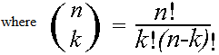
Binomial distribution
two possible outcomes in n independent trials, then the probability of exactly X “successes”=
n = number of trials
1-p = probability of failure
X = # successes out of n trials
p = probability of success

Slide 69
X= the number of heads tossed in 5 coin tosses
Binomial distribution
p(x)
p(x)
x
0
1
2
3
4
5
number of heads
number of heads

Slide 70
Bernoulli Vs Binomial
1. The random
𝑋 ~ Ber(𝑝)
Example: Heads in one coin flip, P(heads) = 0.8 = p
variable
2. is distributed as a
3. Bernoulli
4. with parameter
𝑌 ~ Bin(𝑛, 𝑝)
Example: # heads in 40 coin flips, P(heads) = 0.8 = p

Slide 71
Poisson Random Variable
Consider an experiment that lasts a fixed interval of time.
A Poisson random variable 𝑋 is the number of successes over the experiment duration.
A Poisson random variable approximates Binomial where n is large, p is small, and λ = np is “moderate”.
Examples:
# earthquakes per year
# server hits per second
# of emails per day

Slide 72
Continuous probability distribution

Slide 73
Continuous random variables
X is a Continuous Random Variable if there is function
f(x) ≥ 0 for -­∞ ≤ x ≤ ∞, such that:
f is a Probability Density Function (PDF) if:
f(x) is not a probability, it is probability/units of X, not meaningful without some subinterval over X

Slide 74
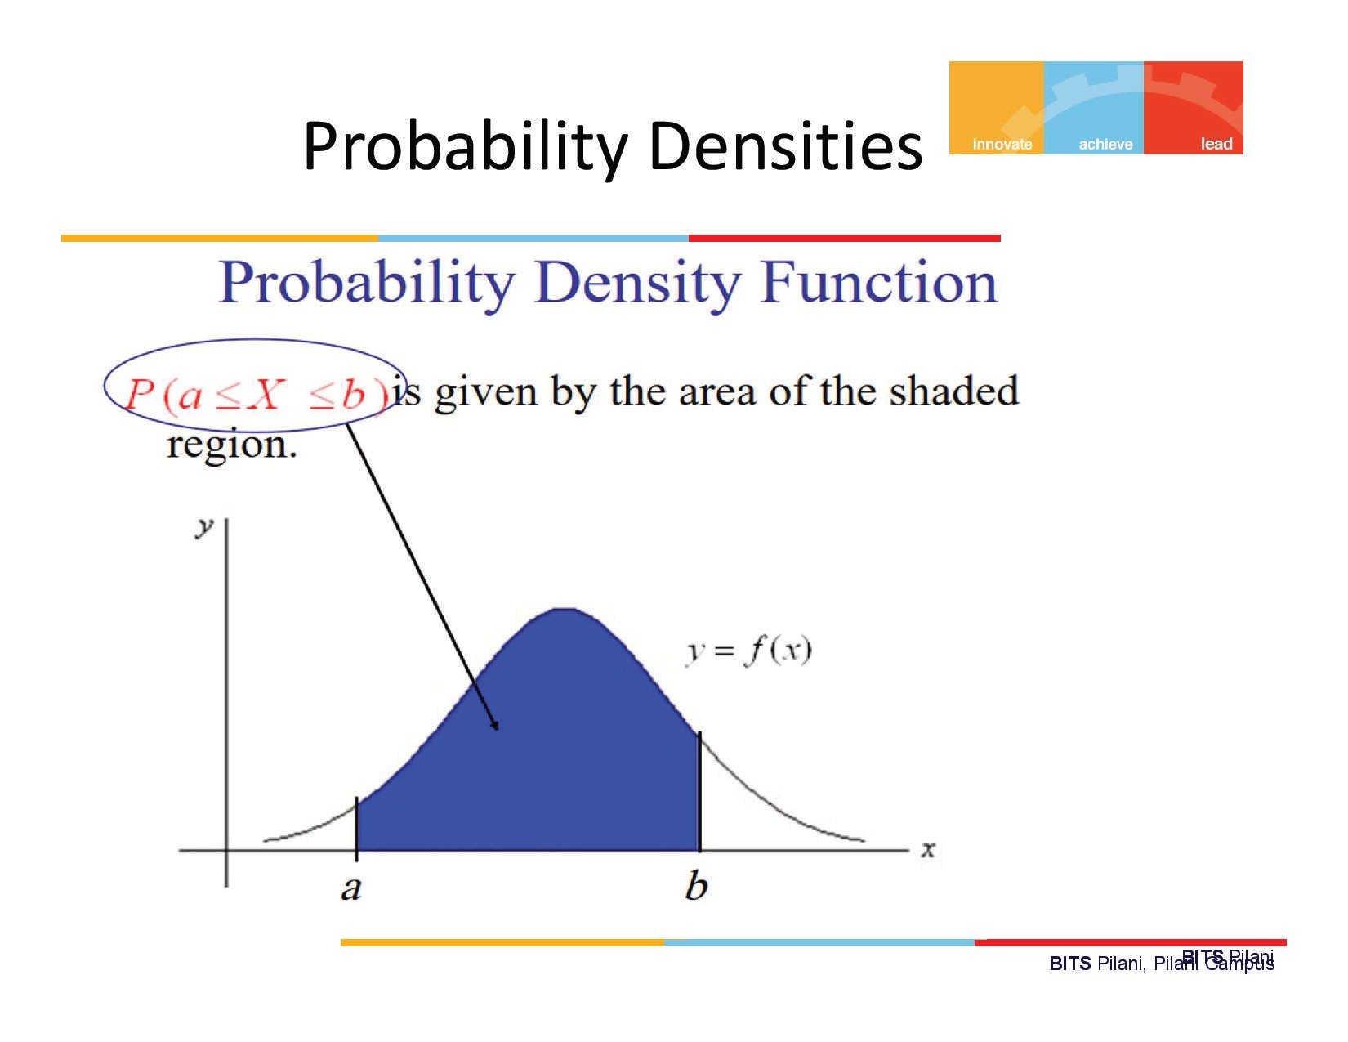

Slide 75
CDF for Continuous random variables
For a continuous random variable X, the cumulative distribution function F(a) is:

Slide 76
Expectation and Variance
For both continuous and discrete RVs:

Slide 77
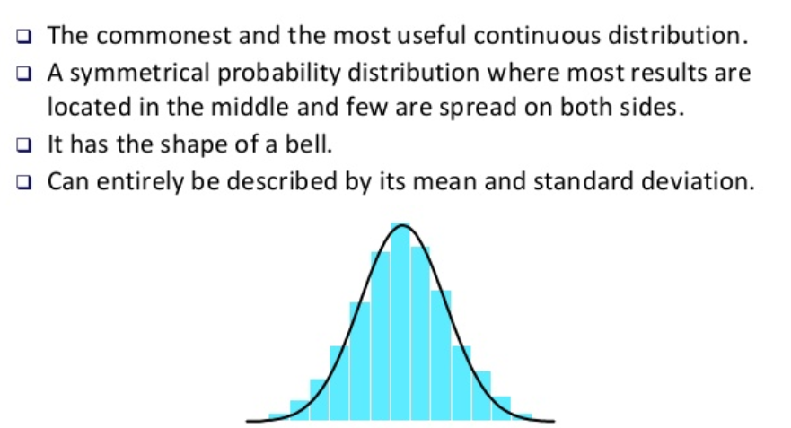
Gaussian Distribution

Slide 78
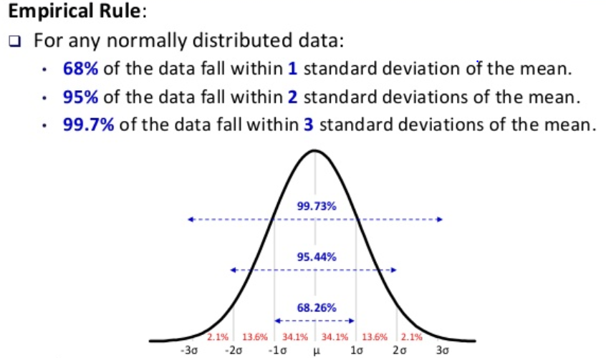
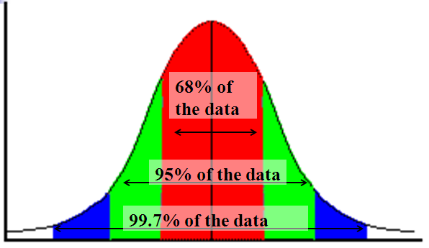
Gaussian Distribution

Slide 79
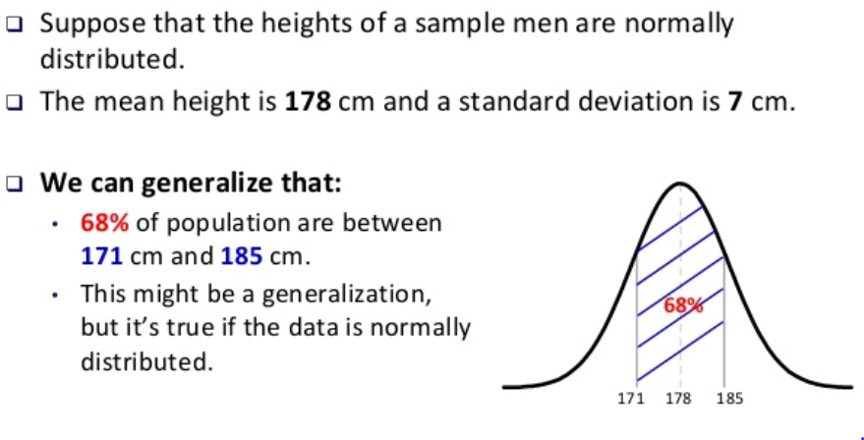
Gaussian Distribution

Slide 80
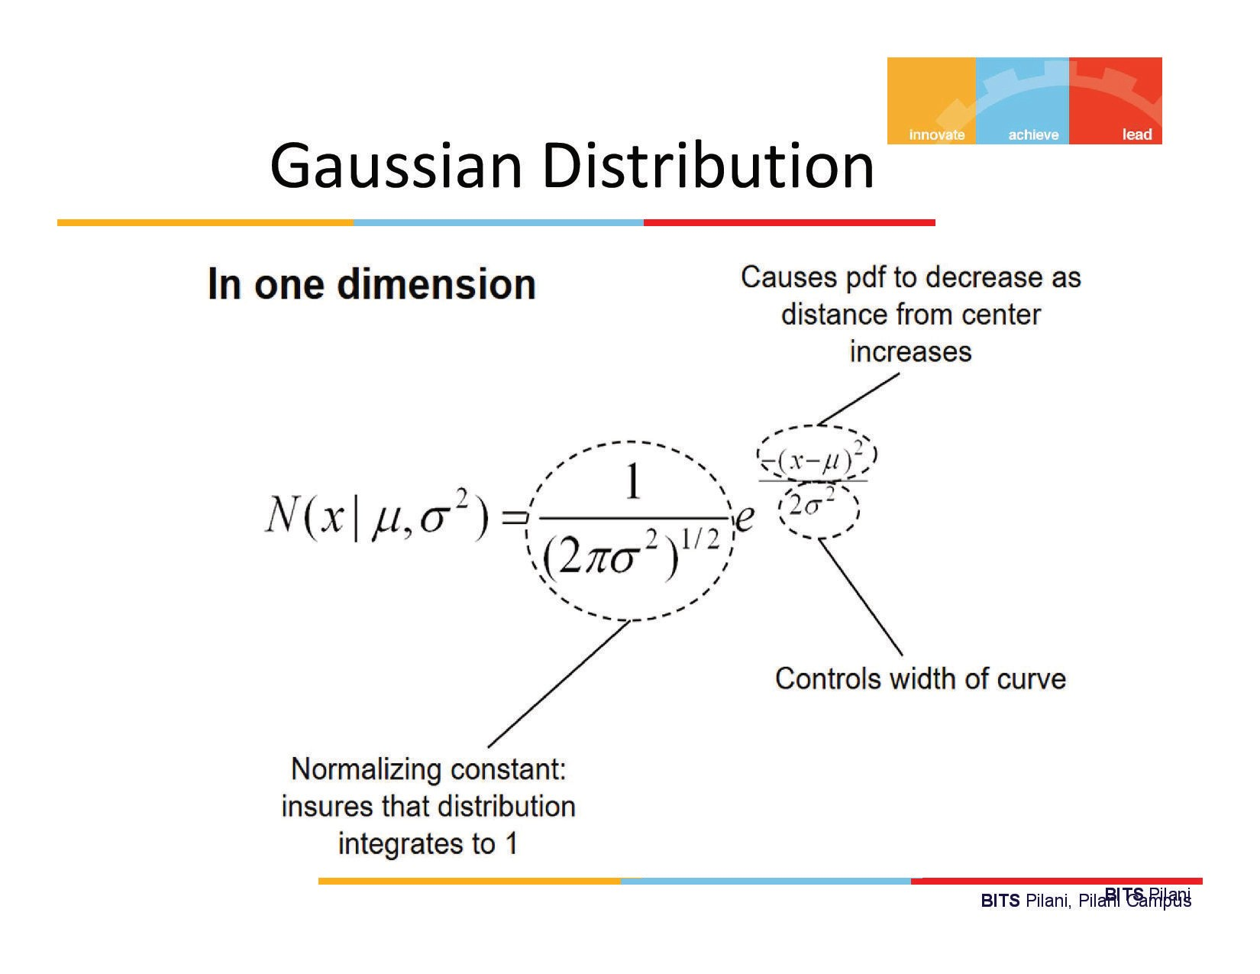

Slide 81
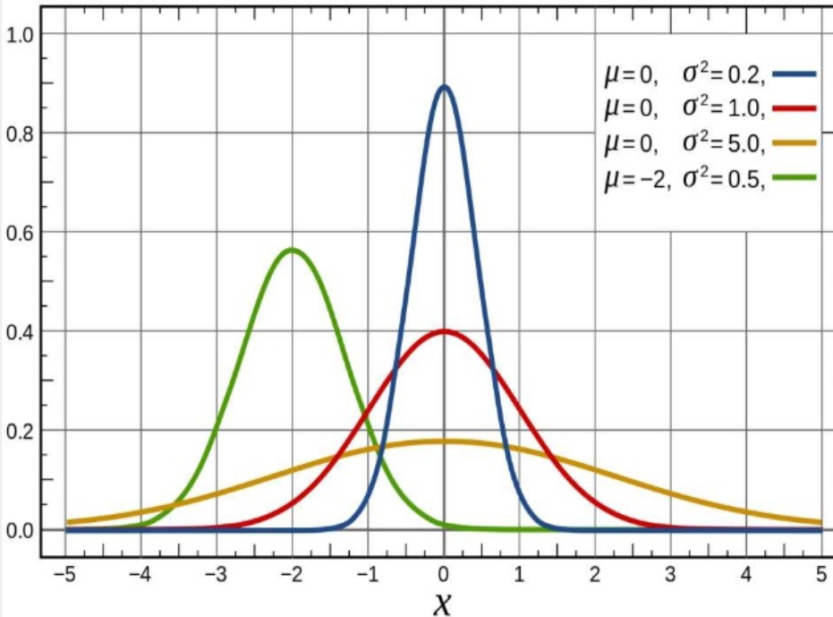
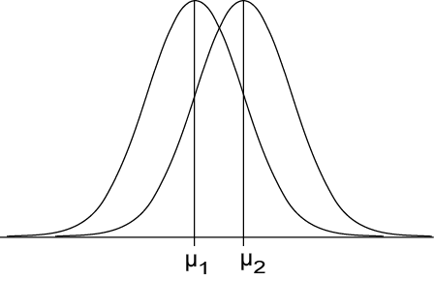
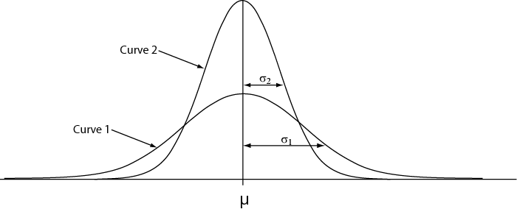
Gaussian Distribution
μ controls location
σ controls spread

Slide 82
Standard - Gaussian Distribution
No closed form for the integral
No closed form for F(x)

Slide 83
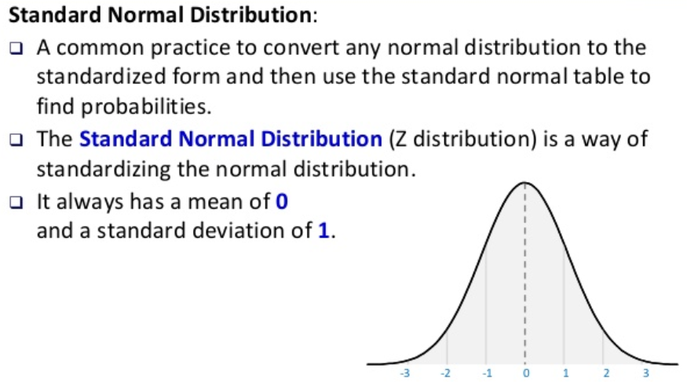
Standard - Gaussian Distribution

Slide 84
Standard - Gaussian Distribution

Slide 85
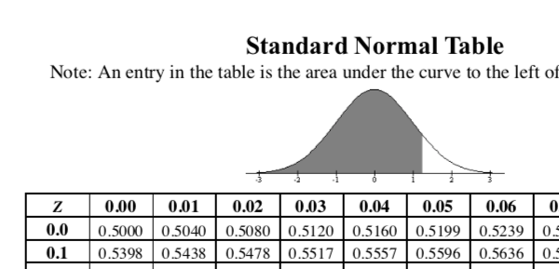
Computing probabilities with Normal RVs
Let 𝑋~𝖭 (𝜇, 𝜎²) What is 𝑃(𝑋 ≤ 𝑥)= 𝐹(𝑥)?
1. Rewrite in terms of standard normal CDF Φ by computing 𝑧 =
Linear transforms of Normals are Normal:
𝑥-𝜇 .
𝜎
_{= Φ} 𝑥 − 𝜇
𝑍= ^{x-𝜇} , where 𝑍~N(0,1)
𝐹 𝑥
𝜎
𝜎
2. Then, look up in a Standard Normal Table, where 𝑧 ≥ 0. Normal PDFs are symmetric about their mean:
Φ (−𝑧)= 1 − Φ(𝑧)

Slide 86


Joint probability mass functions
Roll two 6-sided dice, yielding values 𝑋 and 𝑌.
𝑋
random variable
𝑃( 𝑋 = 1)
probability of an event
𝑃( 𝑋 = 𝑘)
probability mass function
𝑋, 𝑌
random variables
𝑃(𝑋 = 1 ∩ 𝑌 = 6)
𝑃( 𝑋 = 1, 𝑌 = 6)
new notation: the comma
𝑃(𝑋 = 𝑎, 𝑌 = 𝑏)
The marginal distributions of the joint PMF are defined as:

Slide 87
Multinomial distribution
The multinomial is a generalization of the binomial.
It is used when there are more than 2 possible outcomes
partitioning n trials into 3 or more outcomes (with probabilities: p_{1,} p_{2,} p_{3,}..)
General formula for 3 outcomes:

Slide 88
Multinomial example
randomly choosing 8 people from an audience that
contains 50% democrats, 30% republicans, and 20% green
party, what’s the probability of choosing exactly 4
democrats, 3 republicans, and 1 green party member?

Slide 89
Decision Theory

Slide 90
Decision Theory
Suppose x is an input vector together with a corresponding vector t of target variables
Goal: predict t given a new value for x.
The joint probability distribution p(x, t) provides a complete summary of the uncertainty associated with these variables.
Determination of p(x, t) from a set of training data is called inference and is a difficult problem.

Slide 91
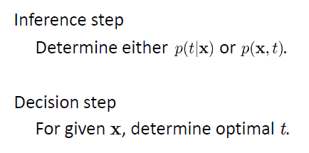
Decision Theory

Slide 92
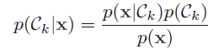
Example : Medical diagnosis problem
Input: X-ray image of a patient
Input vector x is the set of pixel intensities in the image
Output: Presence of cancer = Class C1,
Absence of cancer, = Class C2.
Choose t to be a binary variable such that
t =0 corresponds to C1 and t =1 corresponds to C2.
We are interested in the probabilities of the two classes given the image, which are given by p(C_{k}|x).
Using Bayes’ theorem,

Slide 93
Minimum Misclassification Rate
Divide the input space into regions Rk called decision regions, one for each class, such that all points in Rk are assigned to class Ck
Boundaries between decision regions are called decision boundaries or decision surfaces
A mistake occurs when an input vector belonging to class C1 is assigned to class C2 or vice versa.

Slide 94
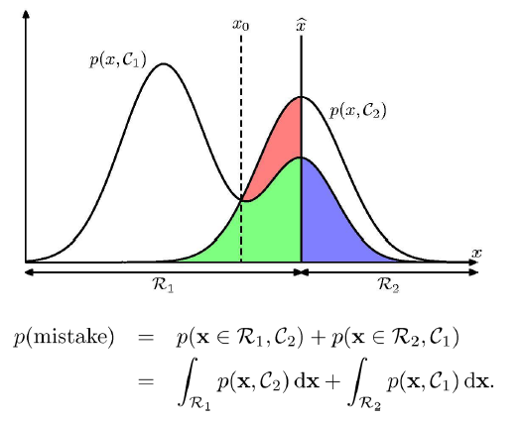
Minimum Misclassification Rate

Slide 95
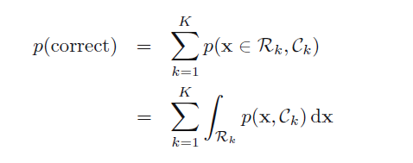
Minimum Misclassification Rate

Slide 96
References
https://web.stanford.edu/~boyd/vmls/vmls.pdf
https://ocw.mit.edu/resources/res-6-012-introduction-to-probability-spring-2018/index.htm
https://web.stanford.edu/class/cs109/
http://cs229.stanford.edu/section/cs229-linalg.pdf
https://www.alextsun.com/files/distributions.pdf

Slide 97
Thank you !

